Slide 1
Image Contrast Adjustment using Nvidia Performance Primitives (NPP)
Yang Song

Slide 2
Outline
NPP Introduction
Problem Statement
Solution and Result
Further Reading/Resources

Slide 3
What is NPP?
A library of GPU-accelerated image, signal and video processing functions.
Key features:
Arithmetic and Logical Operations
Statistical Operations
Filter Functions, etc.
Performance
5x ~ 10x than CPU-only implementation.
Amount
Around 4000 in CUDA 5.0.

Slide 4
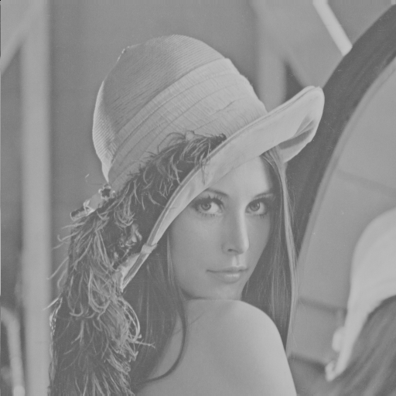

Problem Statement
Hazy source image lacks contrast.
Adjustment algorithm (8-bit image):
Offset and scale image, such that darkest pixel is mapped to 0 and brightest pixel is mapped to 255
$pDst\left(i,j\right)=255×\frac{pSrc\left(i,j\right)−nMin}{nMax−nMin}$
Three operations needed:
MinMax, Subtract and Multiply
Good News!
NPP has them all ☺

Slide 5
Solution
Load image on host
Copy image from host to GPU
Call nppiMinMax, nppiSubC, nppiMulC
You have to fill in
this part.
Transfer result
back to host
Output the image.

Slide 6
NPP Image Representation
Image is represented by two parameters:
pSrc: pointer to the first pixel of the image
nSrcStep: number of bytes between successive rows
nSrcStep
pSrc
145 145 143 145 147 142 141 134 131
146 148 146 146 146 145 139 140 143
145 149 146 145 144 146 142 139 130
147 147 149 146 145 146 133 128 119
145 143 143 145 143 145 136 137 121
136 137 132 131 131 132 128 121 110
155 157 155 158 157 156 154 140 146
158 156 159 158 158 157 155 149 120
oROI
pSrc
with offset
Notes:
Explain the image data storage. The first pixel of the image. Line stride in bytes.

Slide 7
Function Naming
nppiMulC_8u_C1IRSfs
npp
i: image module (s: signal module)
MulC: primitive name (Add, Sum, etc.)
8u: data type of the image (16u, 32s, 32f, 64f, etc.)
C1: single channel (C3R, C4R, AC4R, etc.)
I: in-place (out-of-place if not specified)
R: work on ROI (region of interest)
Sfs: allow result scaling

Slide 8
Read Image
Host (CPU)
Device (GPU)
cudaMemcpy2D
pSrc_Dev
pSrc_Host
nSrcStep_Dev
145 145 143 145 147 142
146 148 146 146 146 145
145 149 146 145 144 146
147 147 149 146 145 146
145 143 143 145 143 145
136 137 132 131 131 132
155 157 155 158 157 156
158 156 159 158 158 157
145 145 143 145 147 142
146 148 146 146 146 145
145 149 146 145 144 146
147 147 149 146 145 146
145 143 143 145 143 145
136 137 132 131 131 132
155 157 155 158 157 156
158 156 159 158 158 157
nHeight
nHeight
nWidth
nWidth

Slide 9
NPP scratch buffer
nppiMinMax_8u_C1R needs device buffer
NPP does not allocate memory internally (unbeknownst to the user).
Offer users max control and flexibility on memory management.
Buffer can be reused to improve performance and avoid device-memory fragmentation .

Slide 10
nppiMinMaxGetBufferHostSize_8u_C1R
Parameter list:
NppiSize oSizeROI → oROI
int * hpBufferSize → &nBufferSize_Host
Notes:
Encourage them to look up the manual.

Slide 11
nppiMinMax_8u_C1R spec
Parameter list:
const Npp8u * pSrc → pSrc_Dev
int nSrcStep → nSrcStep_Dev
NppiSize oSizeROI → oROI
Npp8u * pMin → pMin_Dev
Npp8u * pMax → pMax_Dev
Npp8u * pDeviceBuffer → pBuffer_Dev
Notes:
Encourage them to look up the manual.

Slide 12

Integer-Result Scaling (Part 1)
Avoid the clamping loss on the integer data (especially on 8u and 16u images).
Parameter "nScaleFactor" controls the amount of scaling: $×2^{−nScaleFactor}$
Example: nppsSqr_8u_Sfs()
${255}^{2}=65025$, clamped to 255.
Pass scale factor 8: final result = ${255}^{2}×2^{−8}=254.00390625$, which will be rounded to 254.

Slide 13

nppiSubC_8u_C1RSfs spec
Shift minimum pixel value to 0.
nppiSubC_8u_C1RSfs
const Npp8u * pSrc → pSrc_Dev
int nSrcStep → nSrcStep_Dev
const Npp8u nConstant → nMin, nMax, 255
Npp8u * pDst → pDst_Dev
int nDstStep → nDstStep_Dev
NppiSize oSizeROI → OROI
int nScaleFactor → 0
$$pDst\left(i,j\right)=\frac{pSrc\left(i,j\right)−nMin}{nMax−nMin}×255$$
Notes:
Take SubC as an example. Explain the scale factor here. Explain the 8u_C1RSfs. Use two nppi instead of three. Try to combine the two MulC and DivC together.

Slide 14


Multiplication Step
Scale range to [0, 255].
Problem: nppiMulC_8u_C1IRSfs uses a single Npp8u integer as the constant multiplier, but $\frac{255}{nMax−nMin}=\frac{255}{202−92}=\frac{255}{110}≈2.318182$
If multiply by 2 (nearest integer to actual value) error is 0.318182 (i.e. >30%!!!).
Solution: Integer result scaling!
$$pDst\left(i,j\right)=(pSrc\left(i,j\right)−nMin)×\frac{255}{nMax−nMin}$$
Notes:
Take SubC as an example. Explain the scale factor here. Explain the 8u_C1RSfs. Use two nppi instead of three. Try to combine the two MulC and DivC together.

Slide 15

Integer-Result Scaling (Part 2)
Reduce error using Integer-Result Scaling:
Express exact multiplier (2.318182) as fraction of the form $\frac{n}{2^{−s}}$
Where n is an integer and s is the integer-scale factor.
With s=6 we get $2^{s}$=64. $2.318182×64=148.363648≈148$
$\frac{148}{64}=2.3125$
Difference with exact value 2.318182-2.3125 $≈$0.005681 which is close to the 8-bit pixel quantization error (1/255 $≈$0.003921).

Slide 16
Computing optimal nScaleFactor
int nScaleFactor = 0;
int nPower = 1;
while(nPower * 255.0f / (nMax_Host - nMin_Host) < 255.0f)
{
nScaleFactor ++;
nPower *= 2;
}

Slide 17
nppiMulC_8u_C1IRSfs spec
nppiMulC_8u_C1IRSfs
const Npp8u nConstant → computed
Npp8u * pSrcDst → pDst_Dev
int nDstStep → nDstStep_Dev
NppiSize oSizeROI → oROI
int nScaleFactor → computed

Slide 18
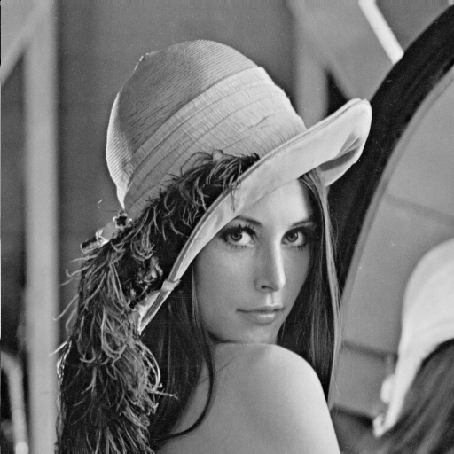
Result
before
after

Slide 19
Further Reading/Resources
NPP is freely available as part of the CUDA Toolkit at www.nvidia.com/getcuda.
Source code samples demonstrating use of the NPP library:
Box Filter with NPP
Histogram Equalization with NPP
FreeImage and NPP Interoperability
Image Segmentation using Graphcuts with NPP

Slide 20
Thank you. Q&A

